Slide 1
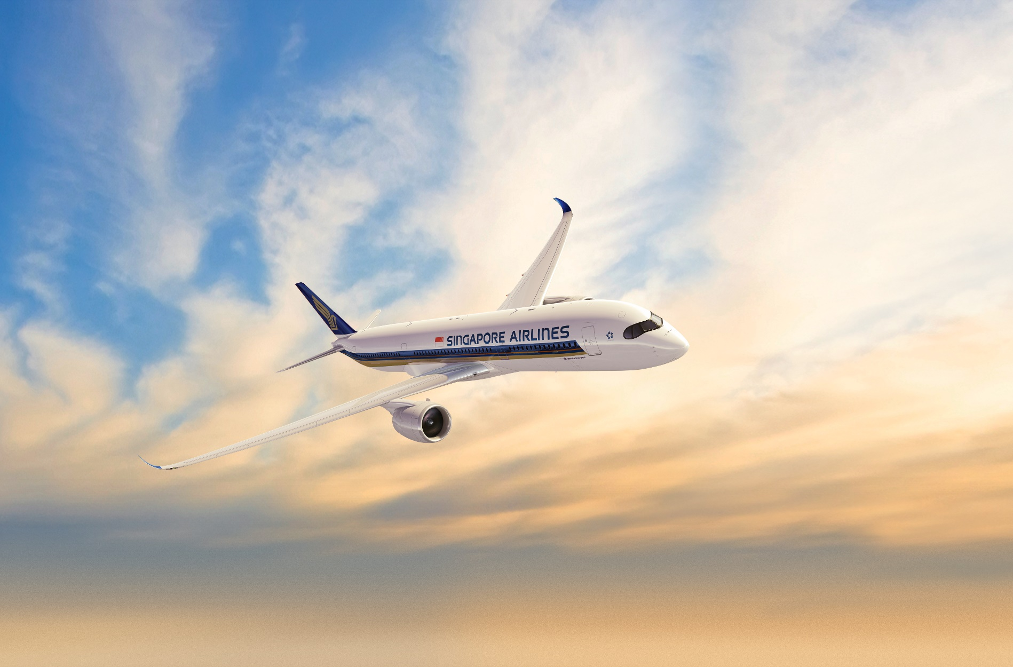
KrisLounge
Faster services, Better experiences
APP CHALLENGE 2020

Slide 2
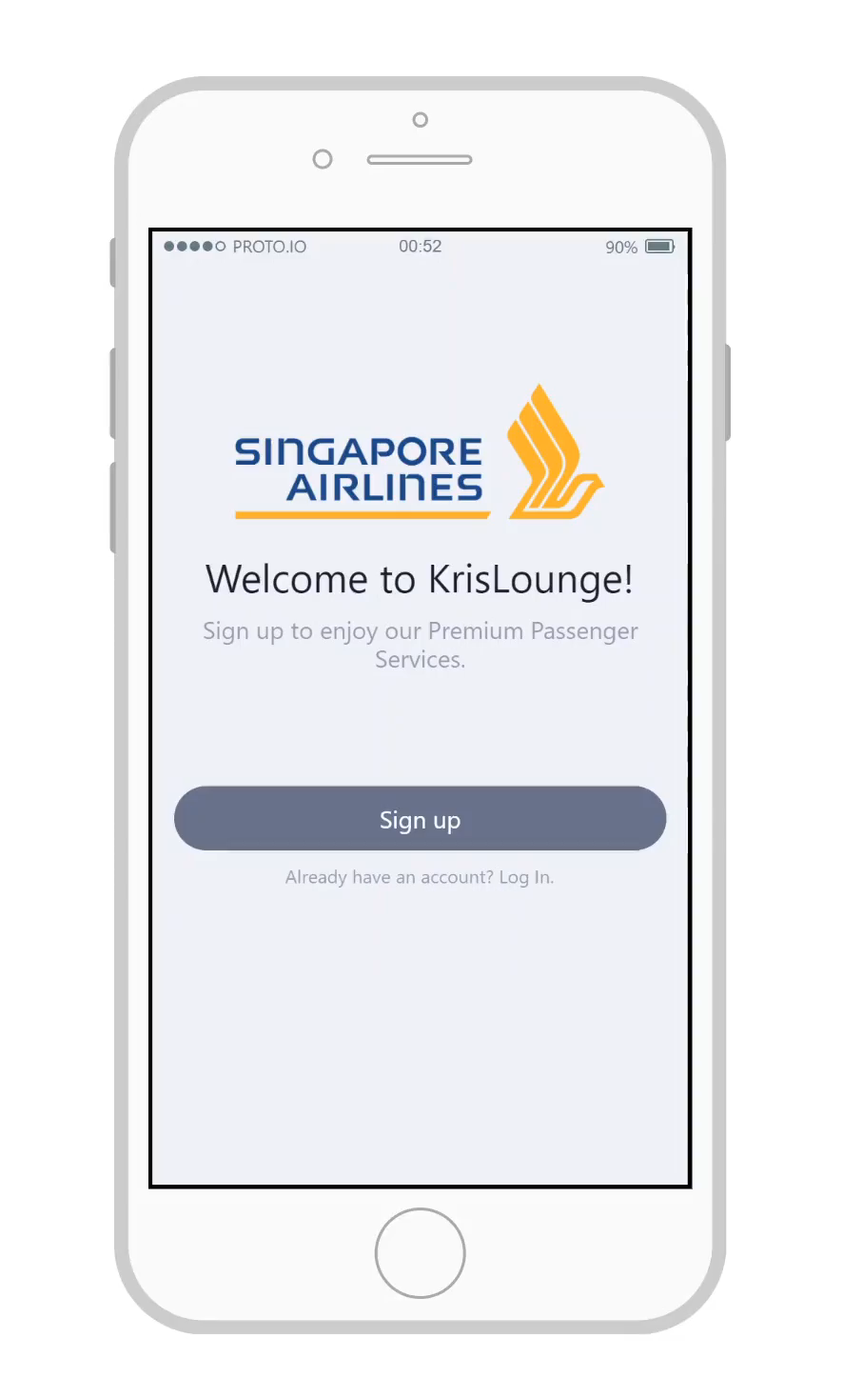

Slide 3
Crucial Elements
Title
Intro
Problem
Research
The name of your proposal. Make it meaningful!
Introduce your team
What is the opportunity or problem you want to solve?
Tell us about your research, hypothesis, insights, surveys, market study etc.
Your
Idea
Technology
Feel free to deviate or mix & match from the format if needed. You may need more, less or entirely different slides depending on your idea.
Present your idea, and the overall value proposition
Explain how it works, the architecture and mechanisms
Business
Value
Project
Plan
Demo
References
Show us some screenshots or videos of your idea if it’s working
What is the projected revenue or savings?
What is needed for your idea to work? Tell us your roadmap?
Links to your documentations and resources if any

Slide 4

Round Robin Hood
Parvathi Menon
Shriya Saxena
T.D.R. Manaswini
Year 3 Computer Engineering Students from the National University of Singapore

Slide 5
Key Challenges of SilverKris Lounge Staff
Trained service staff are present to provide assistance to premium passengers at the lounges, leading to an ineffective management of time
Staff cannot focus on performing servicing tasks that are more complex
Given the current pandemic situation, minimized contact between staff and passengers is preferred
Labor-intensive nature of addressing customer’s queries
Manual Arrangements and Reservations for Shower and Buggy Services
Who does it affect?
Staff required to book a slot for the buggy while working with lounge operator
For shower rooms, passengers will need to approach our staff to obtain a buzzer which will notify them when a shower room becomes available
Time-consuming manual processes with increased contact between staff and passenger

Slide 6
Key Challenges of SilverKris Lounge Premium Customers
Lack of prior information regarding the F&B available at the lounges
Inconvenience to premium customers due to crowding and lack of seats during peak hours
Although a wide range of local and international cuisines are available, customers are not aware of what is being serves and cannot plan their meals ahead
KrisLounge is not able to optimize on providing a customers a unique dining experience wherein their allergies and special requests can be considered
Who does it affect?
Crowding during peak hours interrupts passengers from having a hassle-free experience of relaxing in lounge with family members
Passengers’ seating preferences in different areas of the lounge are not accounted for beforehand, and hence might not be provided to them in times of crowding

Slide 7
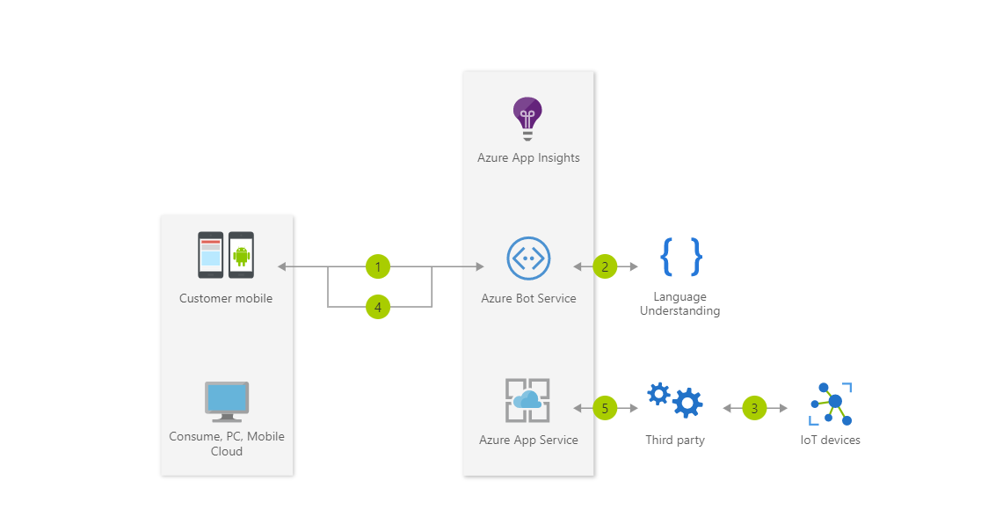
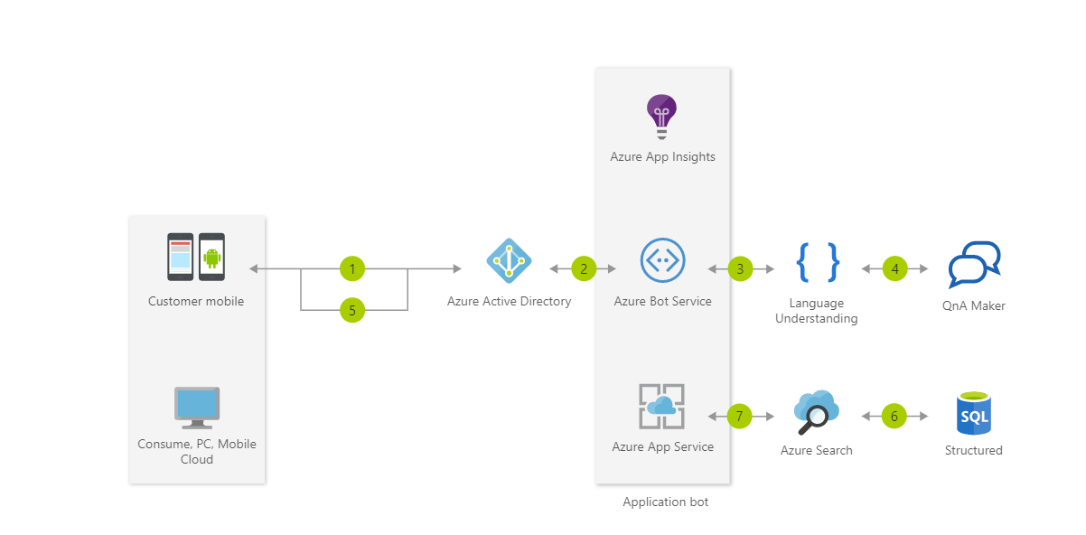
Technical stack that could be used
Development of a native iOS and/or an Android application
Employ Azure services for the Chatbot, IOT sensors and SQL database
Chatbot using Microsoft Azure Services
Detection of seat occupancy using Seat Occupancy Membrane sensors coupled with Microsoft Azure Services

